Slide 1
Executive Director Report
Skagit Valley Casino Resort
Bow WA
October 16, 2012
Joe Finkbonner, RPh, MHA

Slide 2
Personnel
10 years - Health Board Recognition
Stephanie Craig-Rushing
Elaine Dado
Nicole Smith

Slide 3
Personnel
Departing Employees:
Katrina Ramsey
Michelle Edwards

Slide 4
Personnel
New Employees:
Elizabeth Viles (Siletz) – WTDP Project Assistant
Kristyn Bigback (Northern Cheyenne) – IDEA-NW Project Support Specialist/Statistician
Tara Fox (Mandan, Hidatsa & Arikara)- Grants Specialist

Slide 5
Travel
July 2012
  Office of Tribal Government Relations Conference – Grand Ronde
  Prevention Coordinators Meeting – Spokane
  Canoe Journey – Squaxin Island

Slide 6
Travel Cont…
August 2012
  Direct Service Tribes National Meeting – Tucson AZ
  CDC Tribal Consultation Advisory Committee – Mohengan Sun, CT

Slide 7
Travel Cont…
September 2012
  PHAB – Chicago IL

Slide 8
Travel Cont….
Upcoming
  NCAI Annual Conference – Sacramento CA
  October 22-26
  Idaho Tribes/State of Idaho Meeting – Boise
  November 7
  PHAB Board Meeting – Phoenix AZ
  November 27-29

Slide 9
Travel Cont….
Upcoming
  NIHB Board Meeting – Temecula CA
  December 2-4

Slide 10
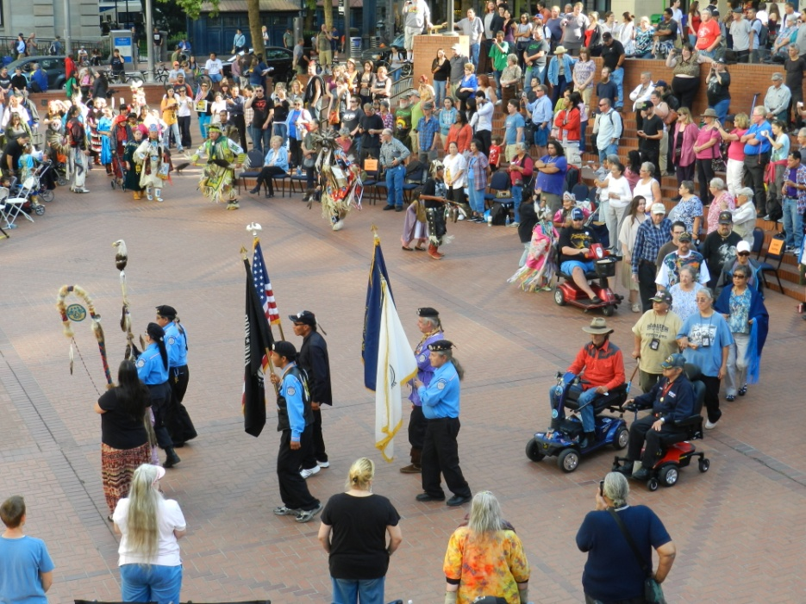
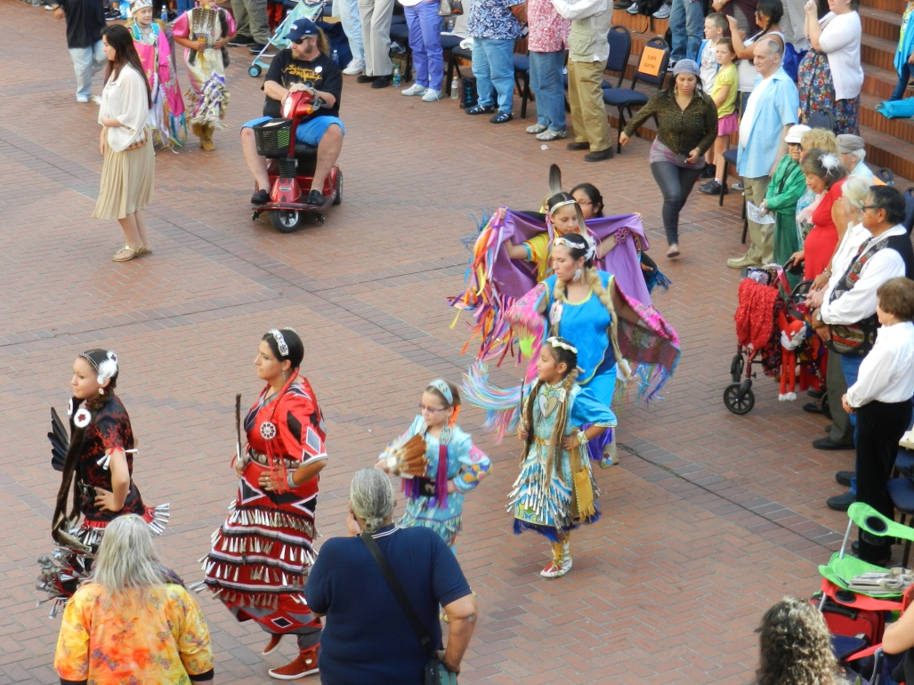
Ongoing Projects
    2012 Audit will begin February 5, 2013
    Indian Day Celebration – huge success!!!!

